Slide 1







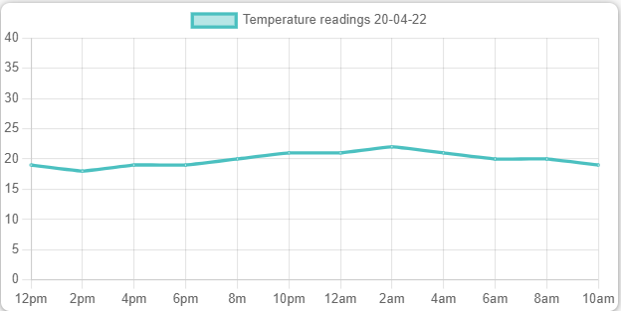

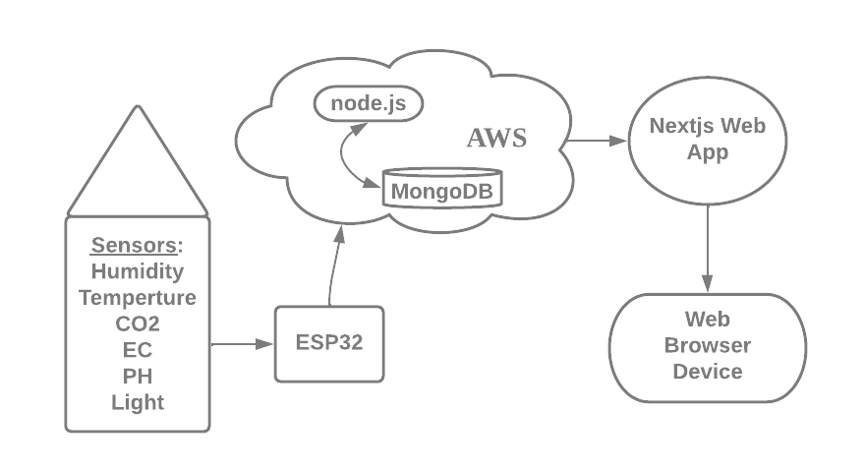
Environment Monitoring System
AONGHUS O DOMHNAILL
Summary
Technologies Used
Results
Aim of project is to monitor and regulate various environment variables, such as temperature, humidity, light, air and water. This is achieved by reading data from sensors on embedded system inside a grow area. Data is sent to a database where user can view via web browser.
Grow area has an automated ventilation, irrigation and artificial light system. This ensures optimum growth and allows adjusting of the environment.
Successfully created web application on MERN stack and hosted on AWS servers.
Monitored an indoor environment and based on data received changed the climate.
Architecture Diagram
Conclusion
In this project you can see the integration of a web server, microcontroller, sensors, and a database server that can be easily adapted into many systems.
Github Repository
For more information visit:
https://github.com/AonghusOD/ProjectCode

